Slide 1
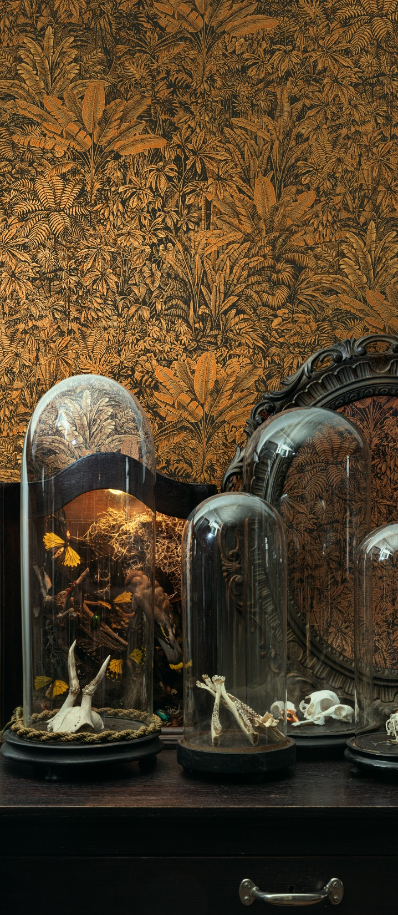

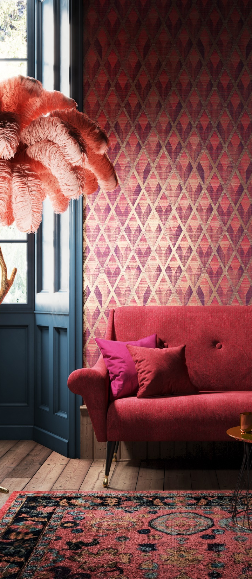
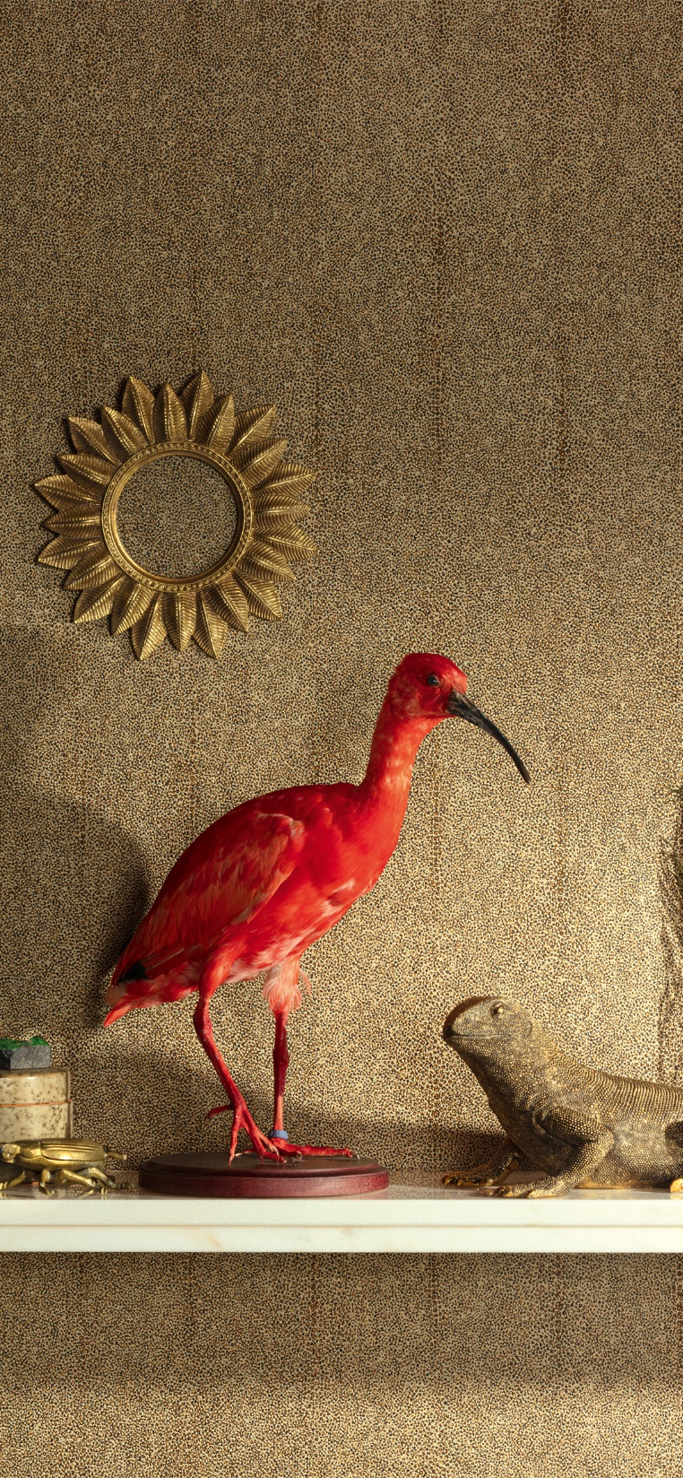
Notes:
Represented in over 70 countries, Masureel shares with its clients a passion for landscaping walls with unique materials.

Slide 2
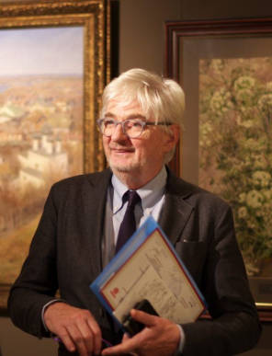
MASUREEL
The company

Slide 3
ROOTS

Slide 4
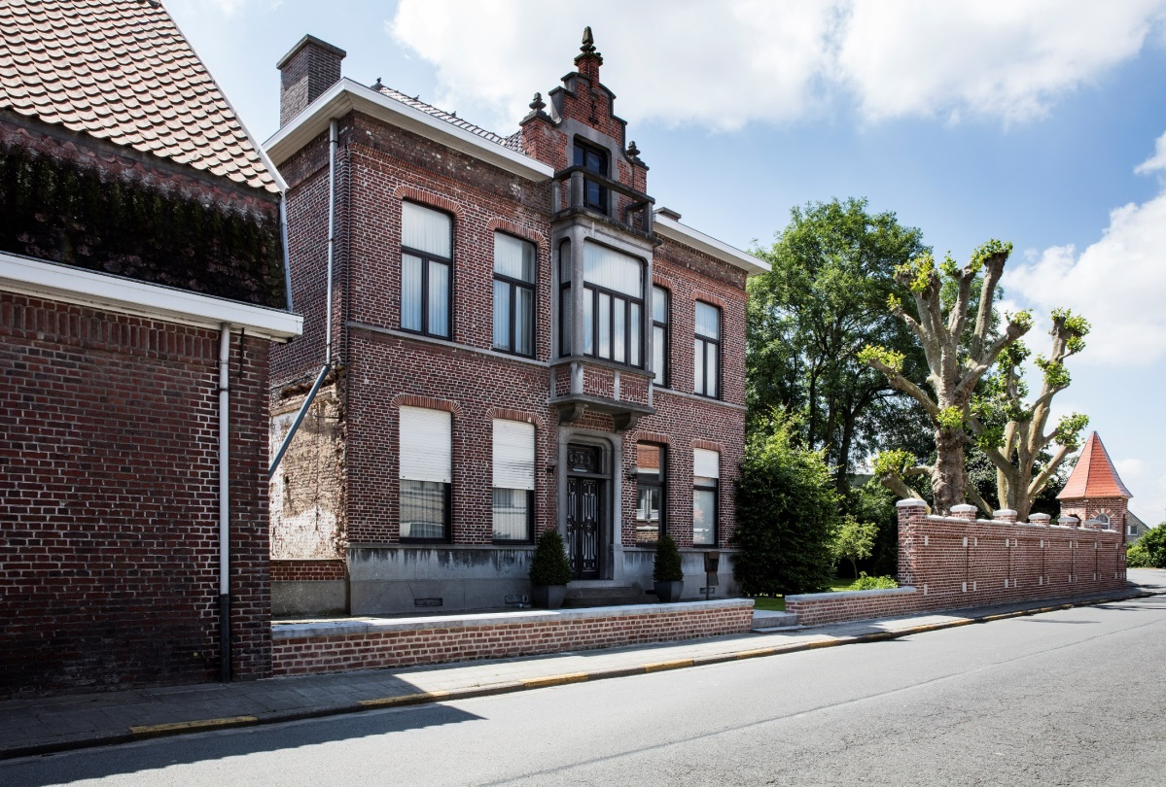
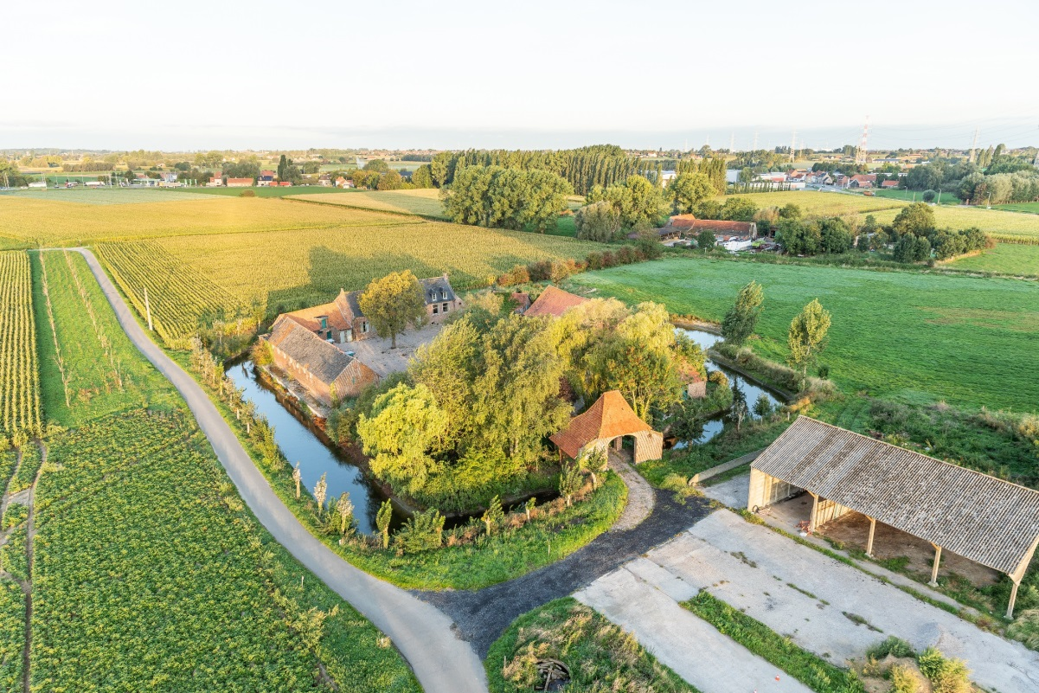
ROOTS
Семейный дом с 1865
Старинная семейная ферма
Goed te Vrijleghem
Notes:
Masureel is a 100% Belgian company that manufactures high quality wallcoverings.
Rooted in the heart of Flanders fields, Masureel holds a longstanding family history in flax growing. We deeply value our heritage and engage ourselves to bridge the gap between art and industry.
The old farmhouse and the mill, the villa we are renovating, the gardens, … they reflect our main aspirations: to blend with history and respect the characteristic landscape of Hulste.

Slide 5
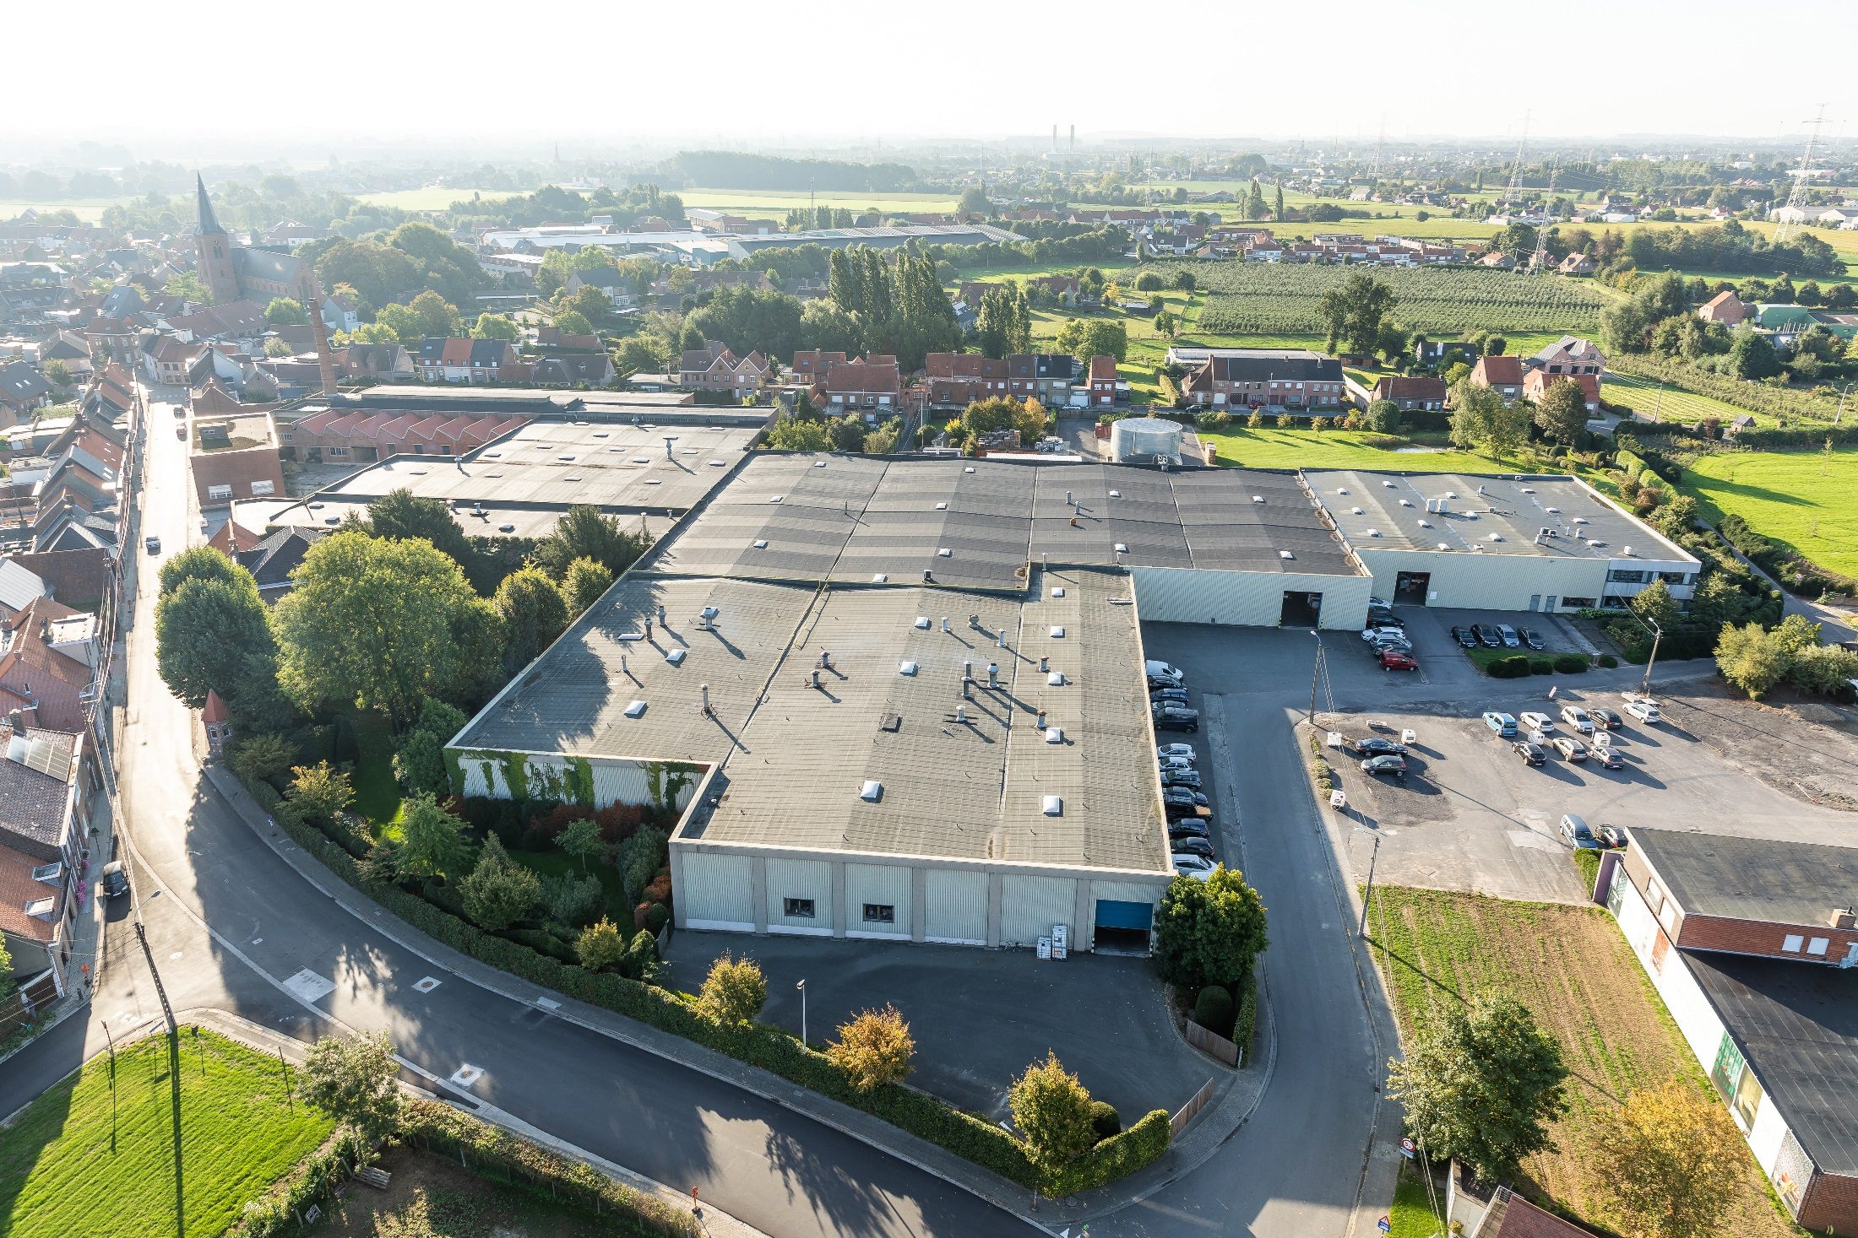
ROOTS

Slide 6
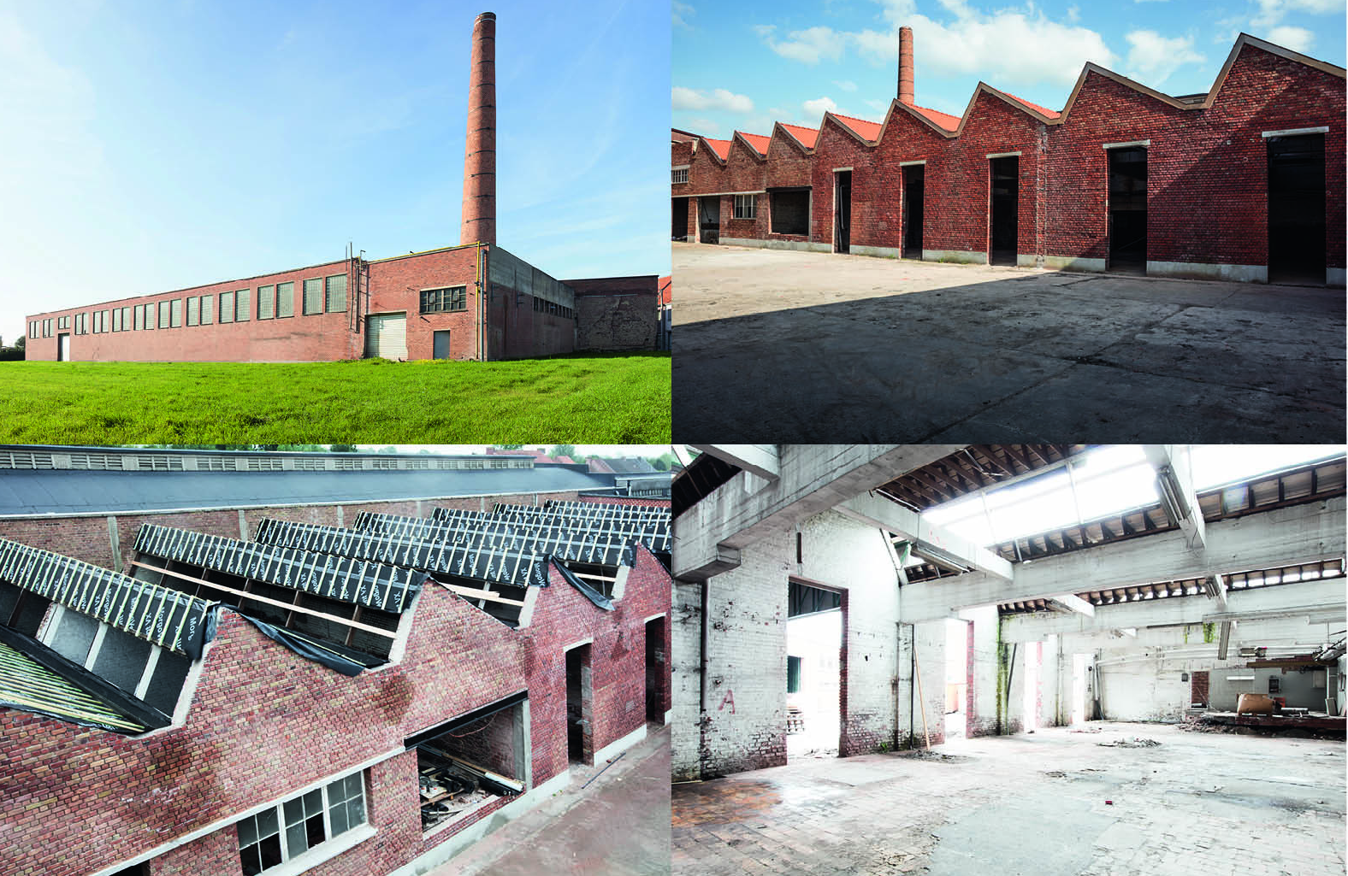
ROOTS

Slide 7
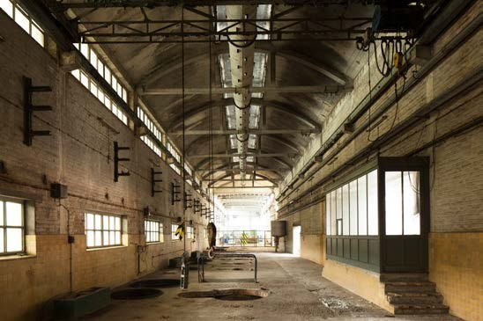
ROOTS

Slide 8
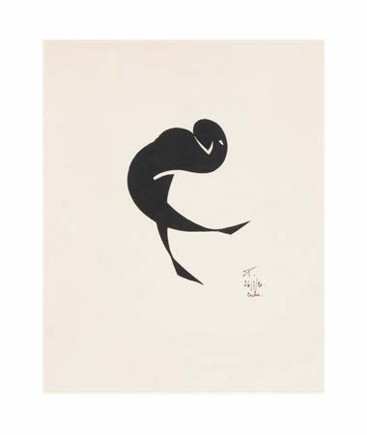
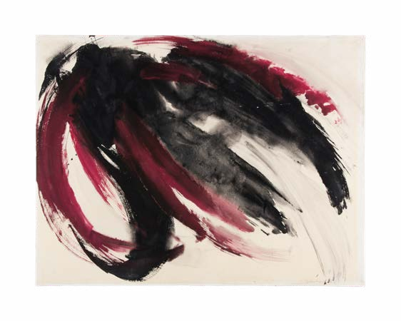
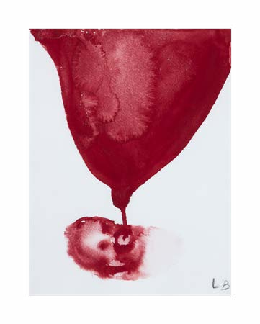
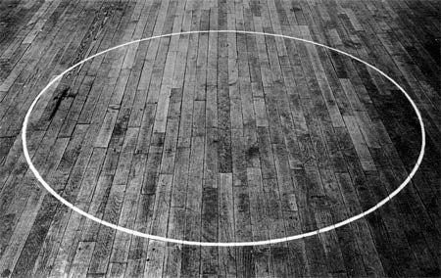
ART
Jozef Peeters Ballerine, 1920
Berthe Dubail Untitled, 1962
Ian Wilson
The Chalk Circle, 1968
Louise Bourgeois The Feeding, 2007
Notes:
Every Masureel brand (Guy Masureel, Khrôma, Zoom, MAF & Topwall) is underpinned by a rich archive of textile designs and an art collection.
This collection is a representation of the philosophy of the Masureel company. It has been built with attention for the human condition in all its aspects and has been an inspiration for our fusion of art and industry.
The persistent creative urge of our designers and the inexhaustible desire to develop the latest techniques in production, lead Masureel to continuously innovate and excel in colour, design and structure.

Slide 9
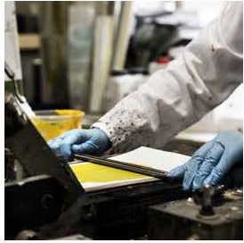
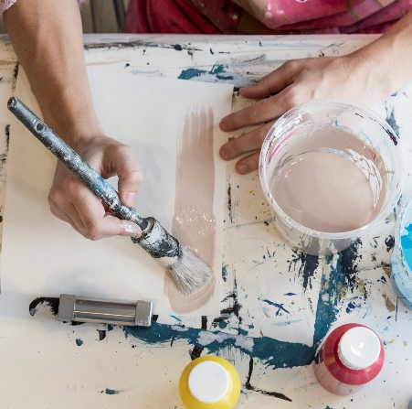
ART
Colour
Texture
Design
Notes:
In our in-house laboratory, the digital image that comes to life during the creation process is transferred to a commercialized industrial image. The colours needed for every design are created in-house by our colorist. These colours are tested on frames with the right designs and an array is printed on wallpaper for the creators to choose from.

Slide 10
ART
Notes:
Every collection is completely made in-house, from design to production.
Creation at Masureel can be explained in three words:
COLOUR – coming from the soul, there is an unconscious tendency to always search for balance between the three primary colours: red, blue and yellow.
TEXTURE – a fusion, created by technology, of manufacturing techniques with silkscreen printing and weaving.
DESIGN – a handmade creation of what our soul wants to express.

Slide 11
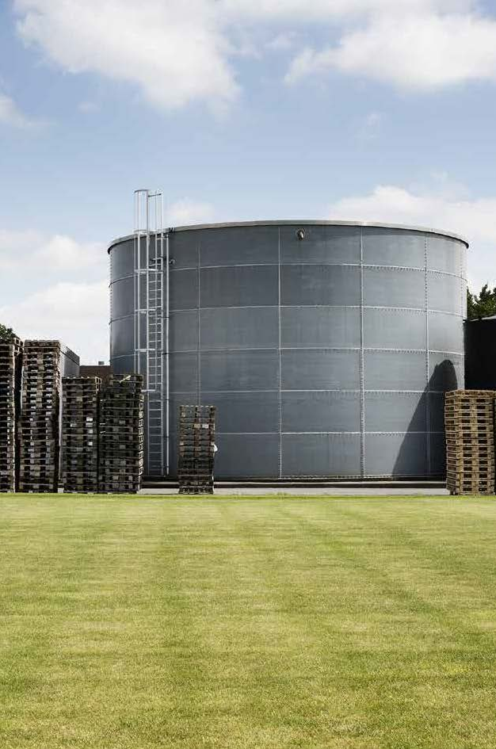
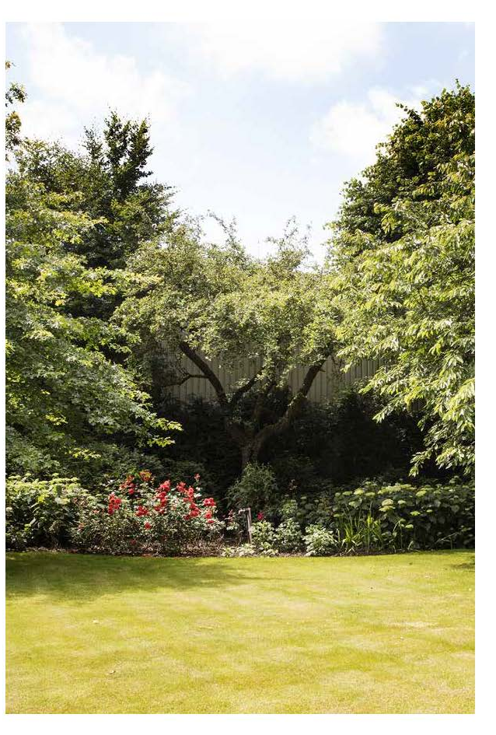
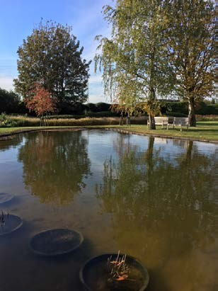
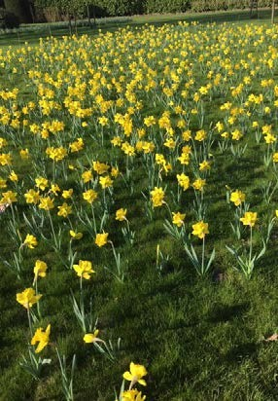
NATURE
In nature, everything is connected.
Notes:
All Masureel products revolve around creativity, quality and green innovation.
Being committed to the environment is for Masureel more than just a statement. We strive for minimal impact in our production facilities as well as for the materials we produce.
No solvents are used, all printing pastes being water-based. Formaldehyde was banned completely. Waste water is treated in our installations and if possible, recycled. Drainage strictly complies with environmental standards. Both the FSC (Forest Stewardship Council) and CE (European Conformity) eco-labels were obtained.
While a fully degradable wallcovering is still behind the horizon, we are taking a step by step approach towards green innovation. Recent developments have proven the feasibility of using recycled materials for wallcovering and with the advent of bio-sourced chemicals, new opportunities are within reach.
Masureel is dedicated to maintain the recognized level of quality and inventiveness and has even taken up the challenge to provide alternatives for PVC wallcoverings.

Slide 12
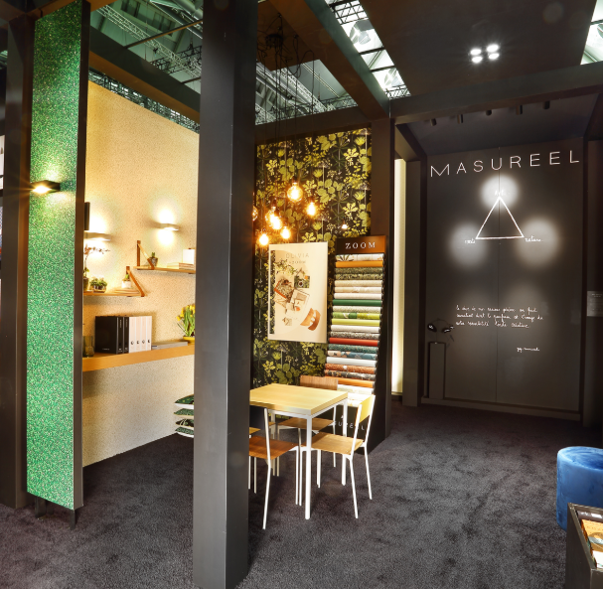
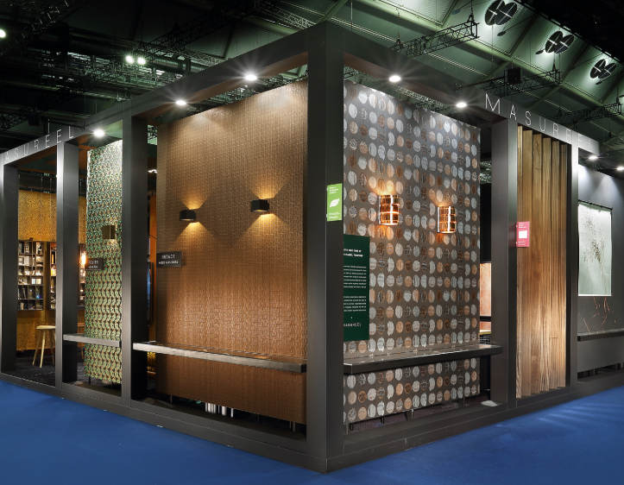
Heimtextil 2020

Slide 13
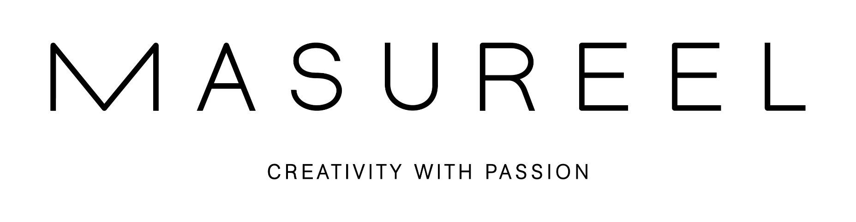
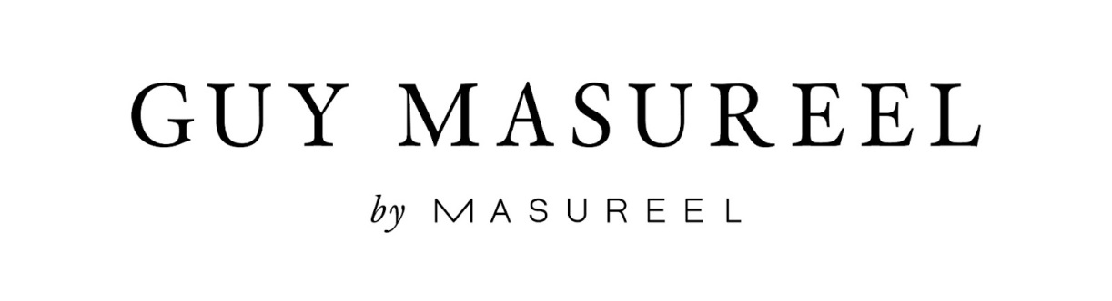

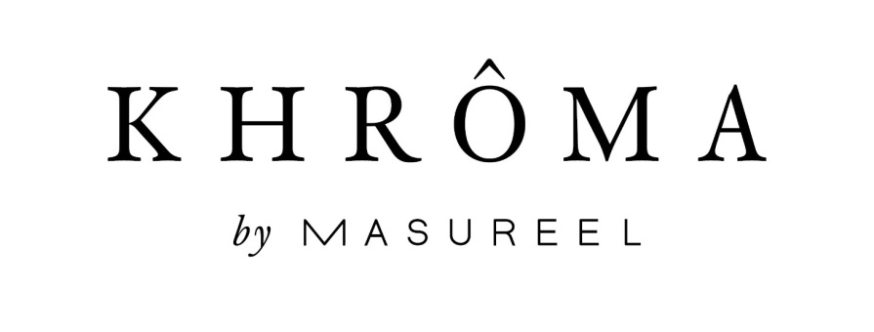
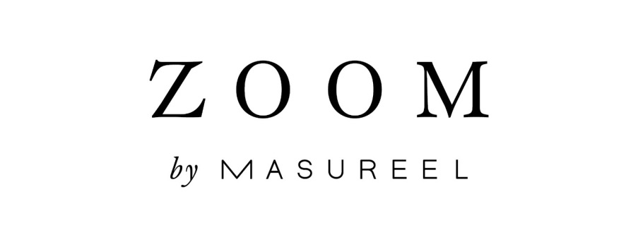
BRANDS

Slide 14

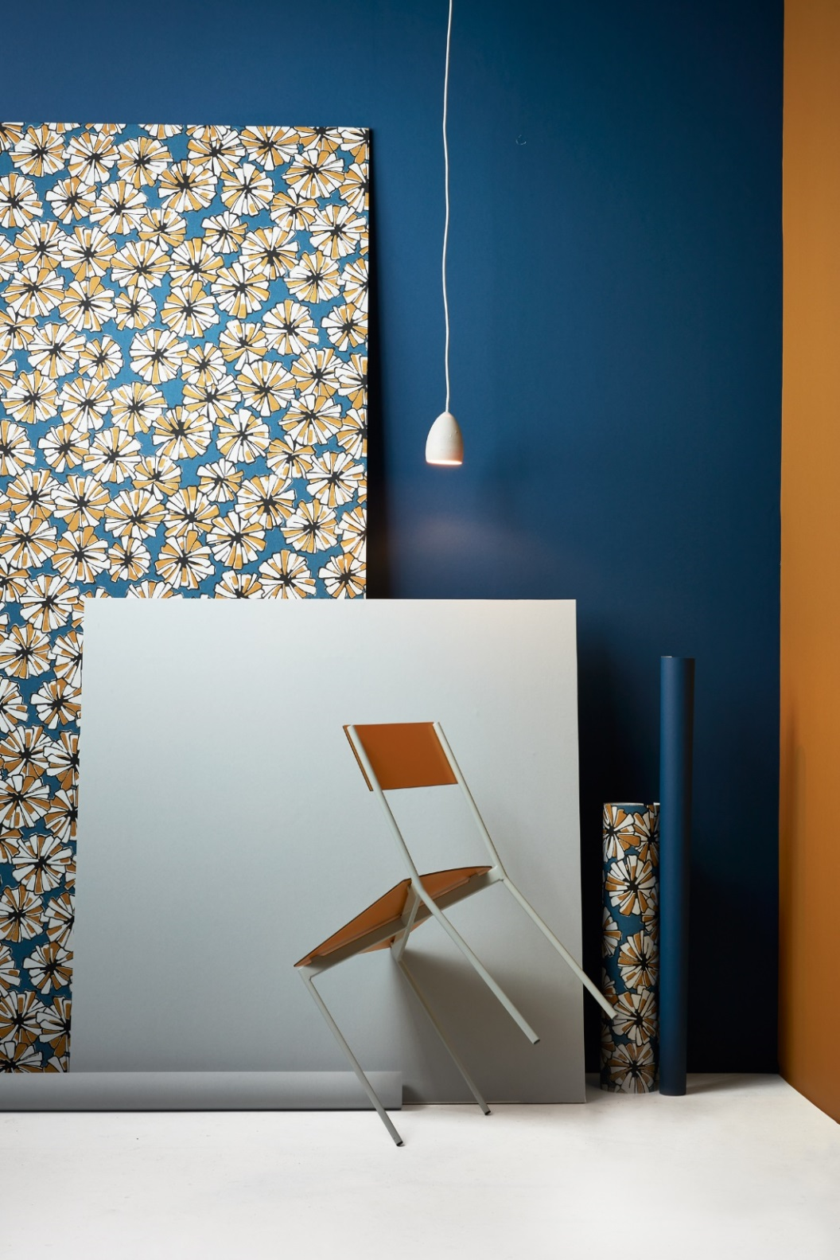
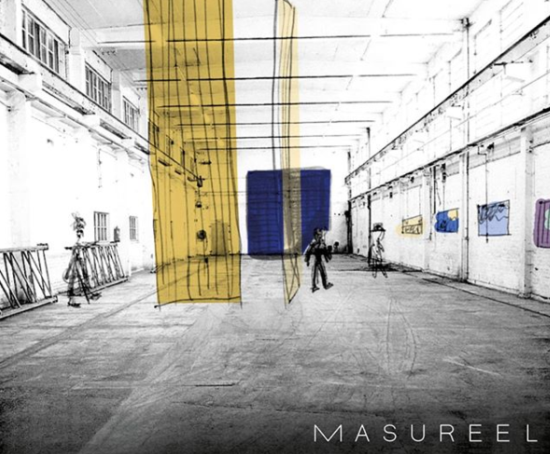
Notes:
Under the name Masureel Art Factory, Masureel collaborates with artists and museums to produce unique wallcovering editions.
We strongly believe that artistic research can challenge and enrich our concept of wallcovering. Our in-house technology and expertise in printing (traditional and digital) helps us to convert the artist’s vision into reality.
SERVRANCKX - The 1920s
_
MAF reissues 4 of Servranckx’s wallpaper designs from the 1920s. The edition is printed on rolls of 70 cm width, using today’s innovated technology, 100 years after the original prints. Our creation team retouched the prints in adjustment of the division of space, attempting to approximate the motifs’ ratio of the original designs. In order to maintain the hand-printed character of the originals, the motifs were repainted. The colours and textures of the paint were carefully balanced in our laboratory. Executed on a non woven support, these vintage designs can meet current quality standards and revive in a contemporary environment.

Slide 15
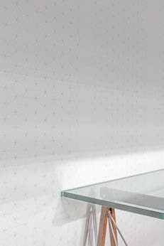
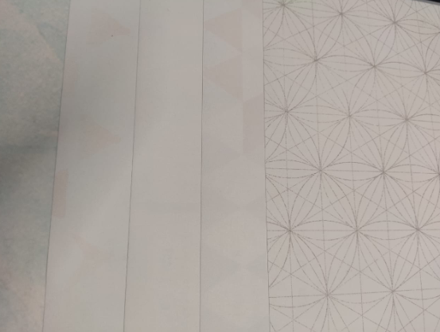
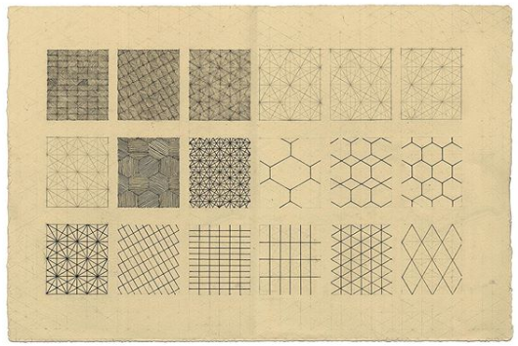
MAF - EDITIONS
Lore VANELSLANDE, Running With Light, 2017 (an Art Factory edition)
Notes:
Lore Vanelslande (1983, Ieper) graduated in 2007 from KASK - School of Arts in Ghent, as a Master in Textile Design. The concentration, precision and patience we associate with this ancient craft have since been the composing forces of her drawings.
Rather than holding on to a predetermined concept, Lore Vanelslande allows herself to work intuitively. She departs from geometric figures, that gradually grow into complex patterns. Her drawings line with Minimal Art, but also carry a spiritual energy. It is all related to the concept of ‘sacred geometry’: symbols that can be found both in nature and in the ancient structures of sanctuaries all over the world. They can be seen as manifestations of a certain essence, that lies beyond visual reality.
Lore Vanelslande’s work does not want to impose meaning, but opens up to the thoughts and perception of the viewer, which can continuously evolve.
Picture: Lore Vanelslande, 'Basic Matrix', ink on paper, 2016, Masureel Collection

Slide 16
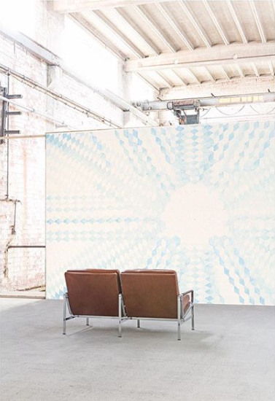
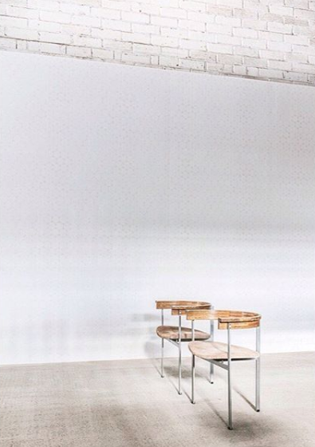
Notes:
MAF edition 1: Lore Vanelslande, Running With Light (DRWL 401), digital print, non woven, 7 panels of 3 x 1.06 m, 2017. Installation view with a sofa by Preben Fabricius and Jørgen Kastholm for E. Alfred Kill –1968.
__
Lore Vanelslande creates an atmosphere of softness and harmony, that transforms a home into a quiet companion. And so the wallcovering becomes a comforting existence, that brings inner peace and helps the body energy to re-align.
This is the digital print of the series 'Running With Light', which extends over 7 panels.

Slide 17
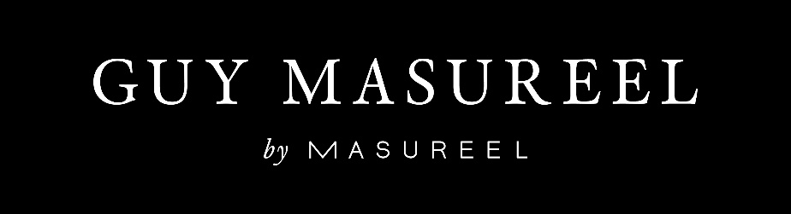
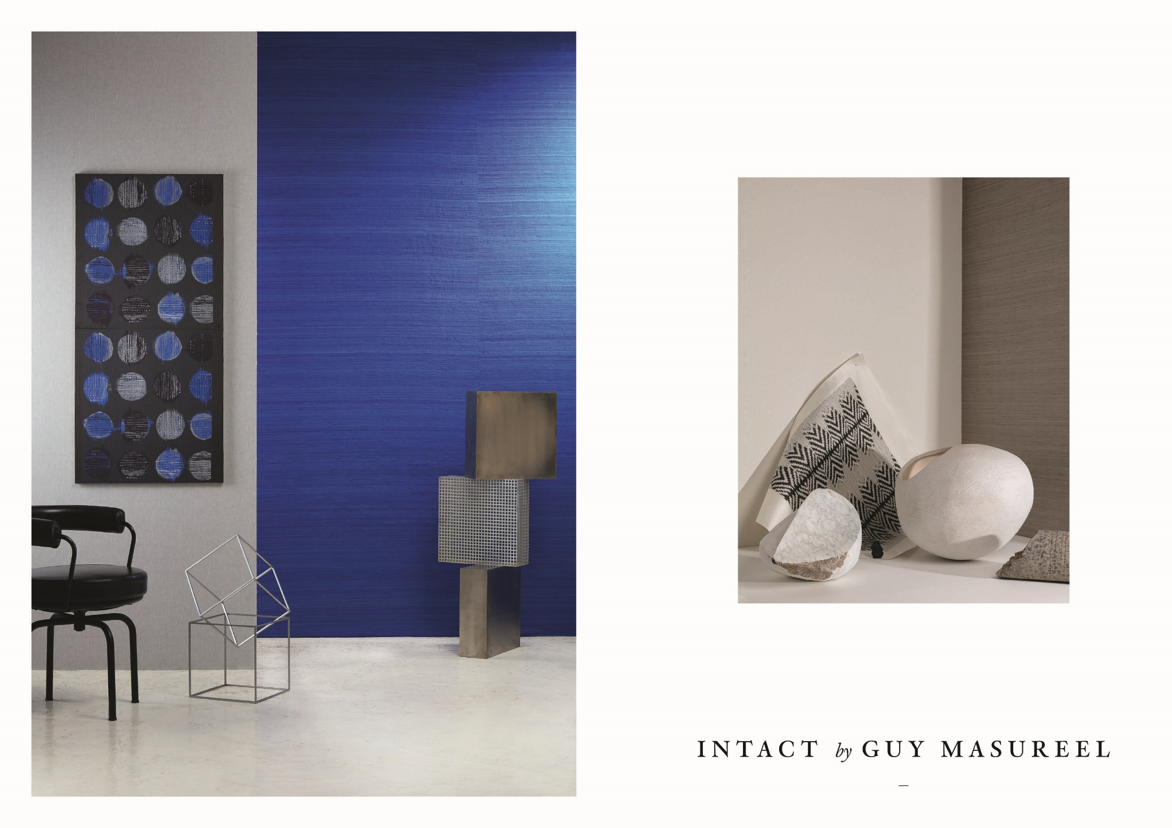

Slide 18
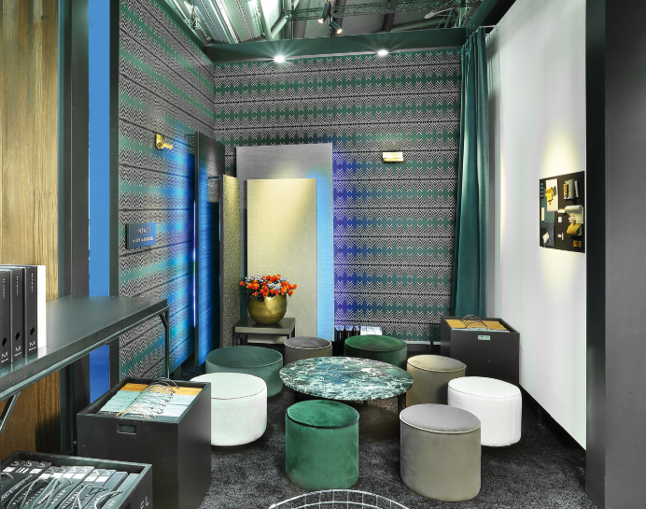
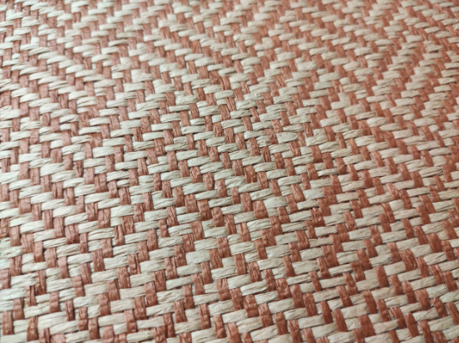
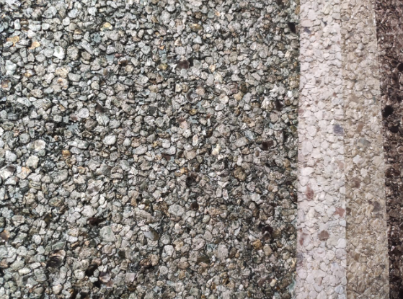
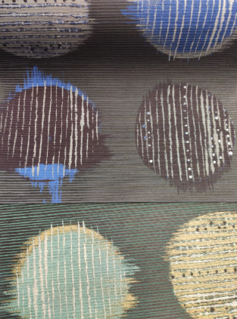
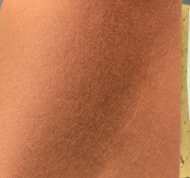
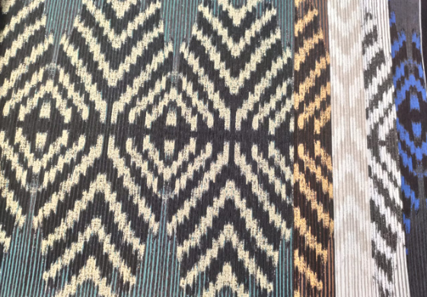
Notes:
Guy Masureel takes a step further from the main wallcovering and fabric ranges, and creates an encounter between art and the senses, carefully crafted in the Masureel laboratory and on the weaving loom. The exclusive Guy Masureel interior is the result of lengths of artistic research and the creative application of ancient techniques, to create its timeless and discrete luxury, its refined presence a gift from the heart.

Slide 19
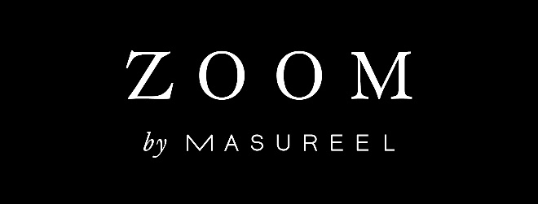
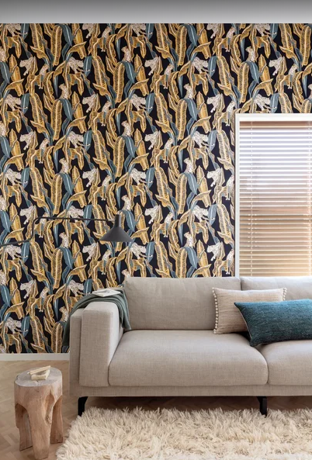
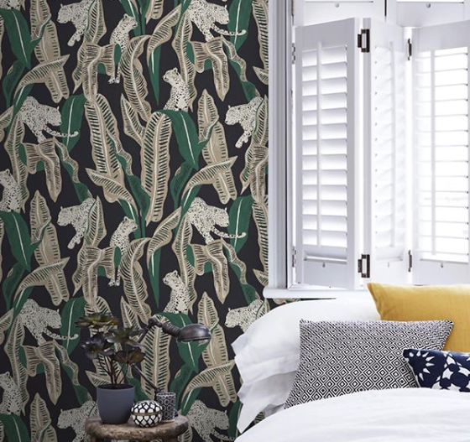
Ombra
Notes:
The Zoom collections combine superior quality with budget. Interpreting classic design with contemporary interior trends, they offer a wide range of solutions for any wall in need of a fresh and outspoken touch of elegance. Distilled from Masureel’s rich creation pool, Zoom guarantees a perfect equilibrium between material and style, and weighs every aspect on the scale of aesthetic expression.

Slide 20
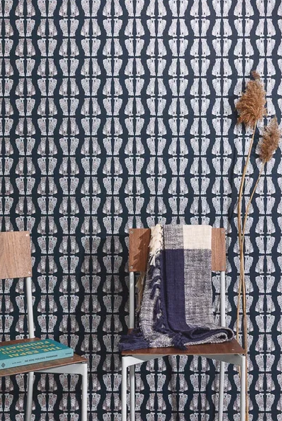
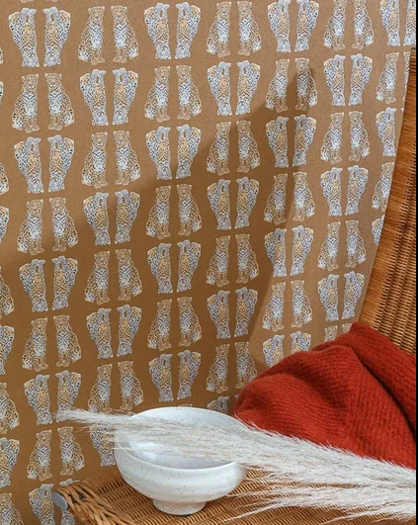
Ombra

Slide 21
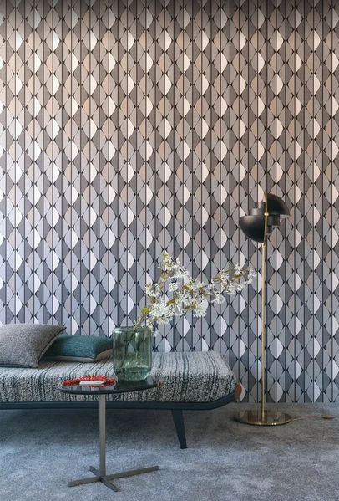
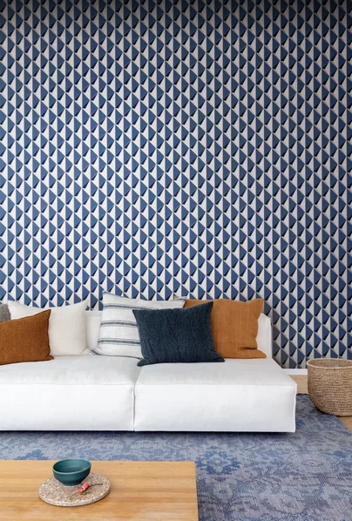
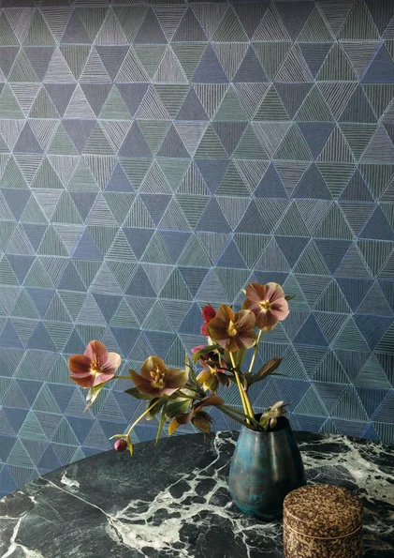
Ombra

Slide 22
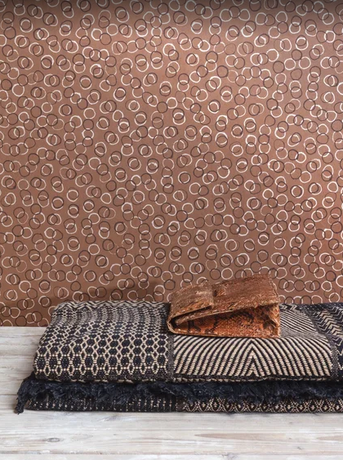
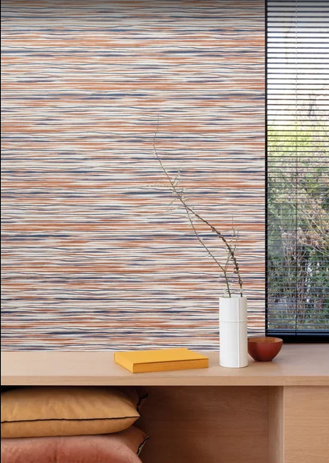
Ombra

Slide 23





Olivia
Notes:
https://artchive.ru/williammorris

Slide 24



Olivia
Notes:
https://artchive.ru/williammorris

Slide 25



Olivia

Slide 26


Olivia

Slide 27


Olivia

Slide 28



Olivia

Slide 29


1001 Night

Slide 30


1001 Night

Slide 31


1001 Night

Slide 32


1001 Night

Slide 33


1001 Night

Slide 34




1001 Night

Slide 35



Orbital

Slide 36






Orbital
Notes:
Khrôma is a library of ‘Stories to live in’. Every Khrôma collection holds a unique and original story, connecting us with the rich heritage of the many cultures on our globe. Elaborate color combinations, innovative structures and ever new designs have established Khrôma as a leading brand in its field. It offers the private and professional interior designer with ample variety, tailoring inspiration for any demanding project. A companion in the search for originality and individuality.

Slide 37



Orbital

Slide 38



Orbital

Slide 39


Orbital

Slide 40

Orbital

Slide 41



Folies

Slide 42



Slide 43



Folies

Slide 44


Folies
Notes:
This week we will be launching our new collection Folies, based upon the spirit of the roaring twenties in Paris.⠀
⠀
The collection is also inspired by the geometric works by Max Forrer. He had his studio in the Rue Richer, close to the Theatre Folies Bergere. Max Forrer captured the spirit like no other with the amazing craftsmanship in his interior designs.⠀
⠀
Source: Original wallpaper design, studio Max Forrer, Rue Richer (Paris), 1920s - Masureel archive.

Slide 45


Folies

Slide 46


Folies

Slide 47

Cabinet of Curiosities

Slide 48


Cabinet of Curiosities

Slide 49


Cabinet of Curiosities

Slide 50


Cabinet of Curiosities

Slide 51


Cabinet of Curiosities

Slide 52


Cabinet of Curiosities

Slide 53


Cabinet of Curiosities

Slide 54



Cabinet of Curiosities

Slide 55




Slide 56


Slide 57


Masureel Art Factory
Running with Light
Guy Masureel
Intact
Khroma
Orbital
Folies
Cabinet of Curiosities
Zoom
Ombra
Olivia
1001 Night

Slide 58


